Slide 1
DFT-D3 for Solid-State Materials: A Data-Driven Perspective on Accuracy
Based on the comprehensive study by Partha Pratim Paul, Vikas Singh Thakur, and Swastika Banerjee*
Harsh Gupta 23321015
CYT 102: Computational Chemistry

Slide 2
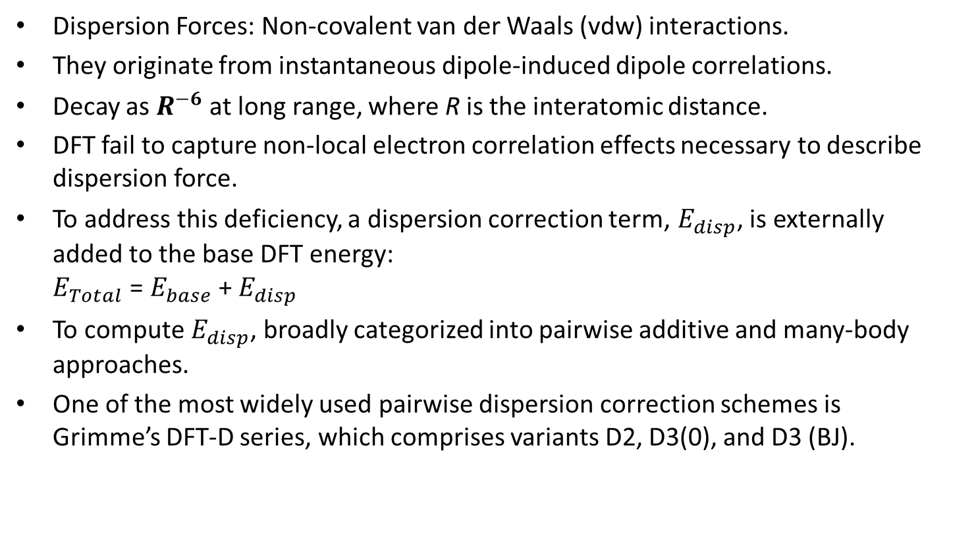
Introduction
Dispersion Forces: Non-covalent van der Waals (vdw) interactions.
They originate from instantaneous dipole-induced dipole correlations.
Decay as $R^{−6}$ at long range, where R is the interatomic distance.
DFT fail to capture non-local electron correlation effects necessary to describe dispersion force.
To address this deficiency, a dispersion correction term, $E_{disp}$, is externally added to the base DFT energy: $E_{Total}$ = $E_{base}$ + $E_{disp}$
To compute $E_{disp}$, broadly categorized into pairwise additive and many-body approaches.
One of the most widely used pairwise dispersion correction schemes is Grimme’s DFT-D series, which comprises variants D2, D3(0), and D3 (BJ).

Slide 3

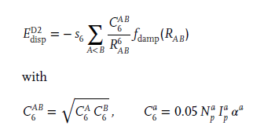
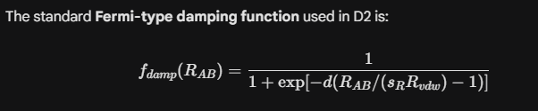

DFT-D Methods
The dispersion correction added to the self-consistent DFT energy is:
The expression for D2-dispersion correction:
In D2, the dispersion coefficients $C_{6}^{AB}$are assigned as fixed atomic pair values.

Slide 4
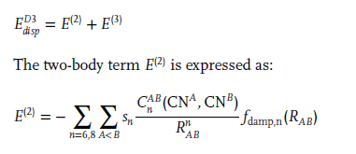


DFT-D Methods
The expression for D3 has two body terms E(2) and three body terms E(3) given as:
A widely used form of the damping function is the zero-damping variant of the D3 correction, denoted as D3(0):
An alternative and more widely adopted damping scheme is the Becke–Johnson damping function, used in the D3(BJ) variant:

Slide 5



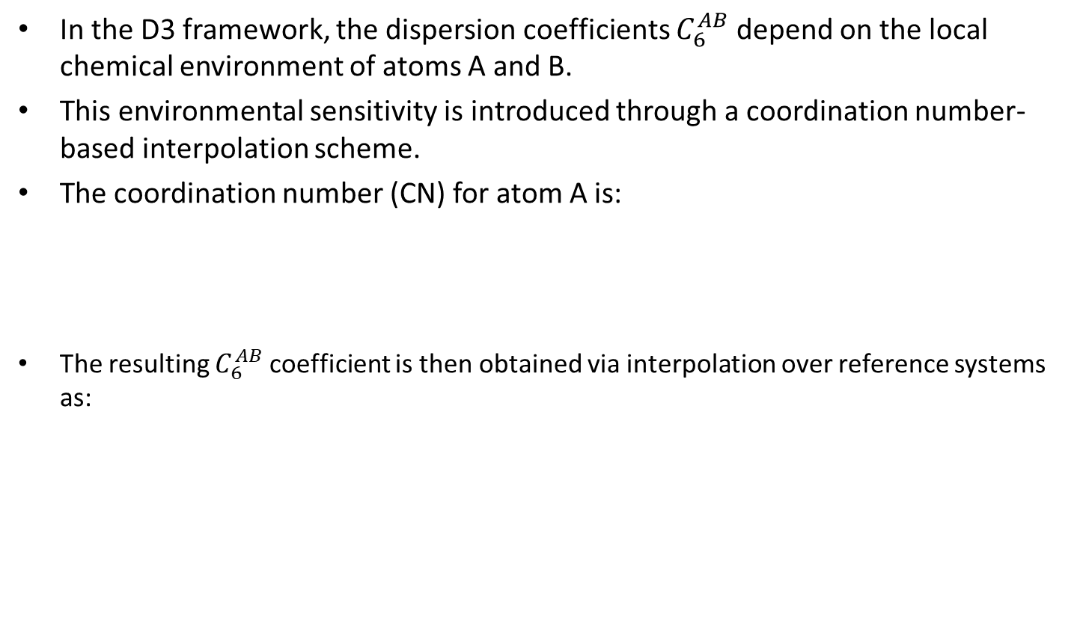
DFT-D Methods
In the D3 framework, the dispersion coefficients $C_{6}^{AB}$depend on the local chemical environment of atoms A and B.
This environmental sensitivity is introduced through a coordination number-based interpolation scheme.
The coordination number (CN) for atom A is:
The resulting $C_{6}^{AB}$coefficient is then obtained via interpolation over reference systems as:

Slide 6
Limitations of DFT-D Methods
Pairwise dispersion correction schemes offer a favorable balance between computational efficiency and accuracy for a wide range of systems.
They inherently neglect many-body polarization and screening effects.
These omissions become particularly critical in extended solids and densely packed phases.

Slide 7

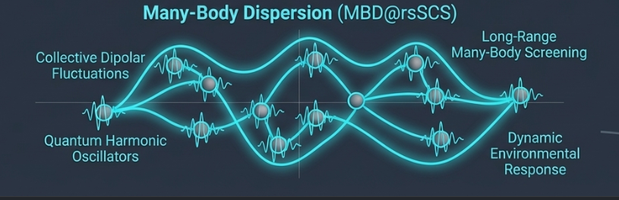
MBD Method
The Many-Body Dispersion (MBD) method addresses these limitations by representing atoms as quantum harmonic oscillators (QHOs) that interact via long-range dipole–dipole couplings
It captures collective dipolar fluctuations and the resulting long-range correlation energy, offering improved accuracy for systems such as molecular crystals and van der Waals heterostructures

Slide 8
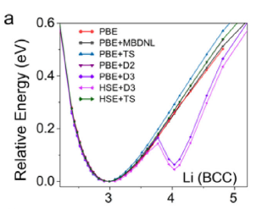
Spurious Minima
A particularly problematic artifact of D3-corrected functionals is the emergence of spurious features in the potential energy surface (PES).
Notably, a secondary minimum may appear near the van der Waals contact distance of interacting species
It is seen in systems with delocalized electrons or high polarizability also can say in ionic and metallic systems.

Slide 9
Artifact Minima in DFT-D3

Slide 10
Two key features of the D3 dispersion scheme

Slide 11
D3 dispersion correction across a broad spectrum of Li compounds
The magnitude and behavior of D3 errors are not governed by stoichiometry alone but are highly dependent on the local coordination environment and electronic character of
the compound.

Slide 12
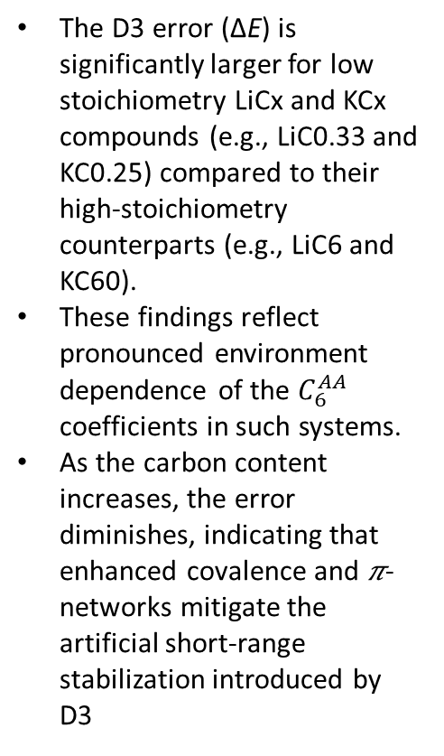
Impact of Structural/Bonding Motifs on D3 Dispersion Errors
The D3 error (ΔE) is significantly larger for low stoichiometry LiCx and KCx compounds (e.g., LiC0.33 and KC0.25) compared to their high-stoichiometry counterparts (e.g., LiC6 and KC60).
These findings reflect pronounced environment dependence of the $C_{6}^{AA}$ coefficients in such systems.
As the carbon content increases, the error diminishes, indicating that enhanced covalence and 𝜋-networks mitigate the artificial short-range stabilization introduced by D3

Slide 13
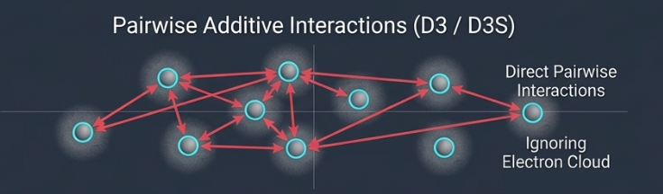

D3S Method
To address these artificial minima, Tkachenko and Head-Gordon proposed the D3S approach.
D3S scheme alleviates a key limitation of D3 by smoothing the coordination-number dependence of atom-pair $C_{6}$coefficients.
By introducing pair-specific $k_{3}^{AB}$ parameters and a 𝜇2-based smoothing criterion, D3S eliminates abrupt $C_{6}$ jumps and thereby reduces the likelihood of spurious minima in dispersion energy profiles.

Slide 14
Comparison Across Various Li-Compounds
D3S constitutes a clear improvement over D3, it does not fully eliminate spurious minima in condensed phases, emphasizing the need for dispersion corrections that extend beyond pairwise smoothing to include explicit electronic and many-body effects for a robust description of ionic and metallic solids.

Slide 15
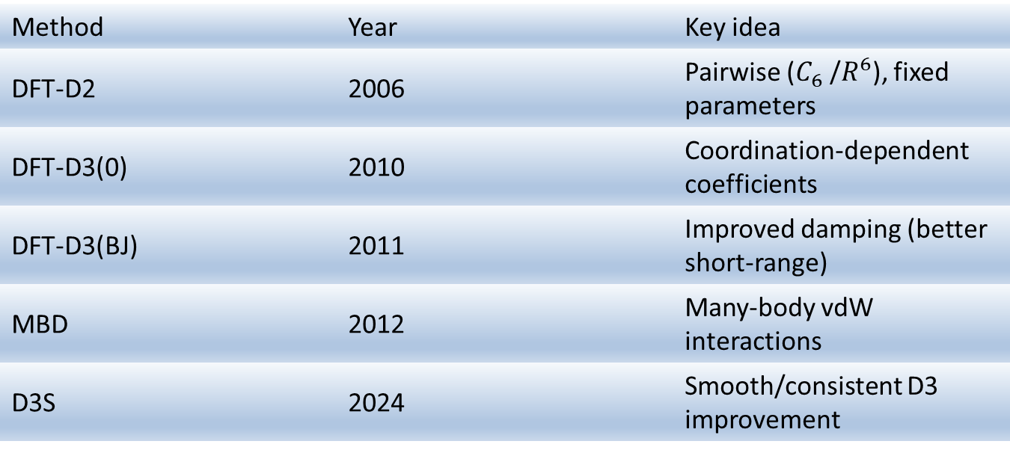
Published Year
Method | Year | Key idea
DFT-D2 | 2006 | Pairwise ($C_{6}$/$R^{6}$), fixed parameters
DFT-D3(0) | 2010 | Coordination-dependent coefficients
DFT-D3(BJ) | 2011 | Improved damping (better short-range)
MBD | 2012 | Many-body vdW interactions
D3S | 2024 | Smooth/consistent D3 improvement

Slide 16
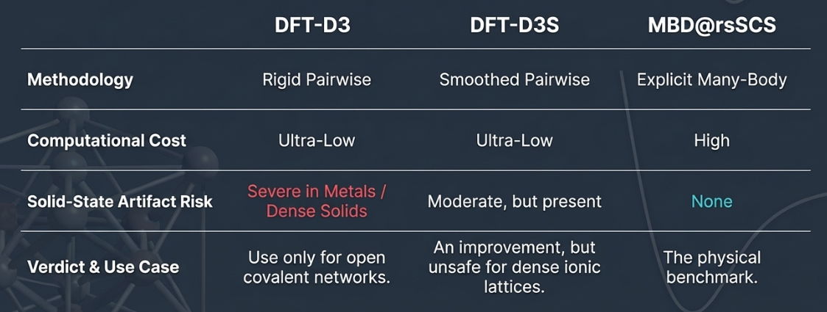
Comparison
MBD remains the physical gold standard but is computationally expensive.

Slide 17
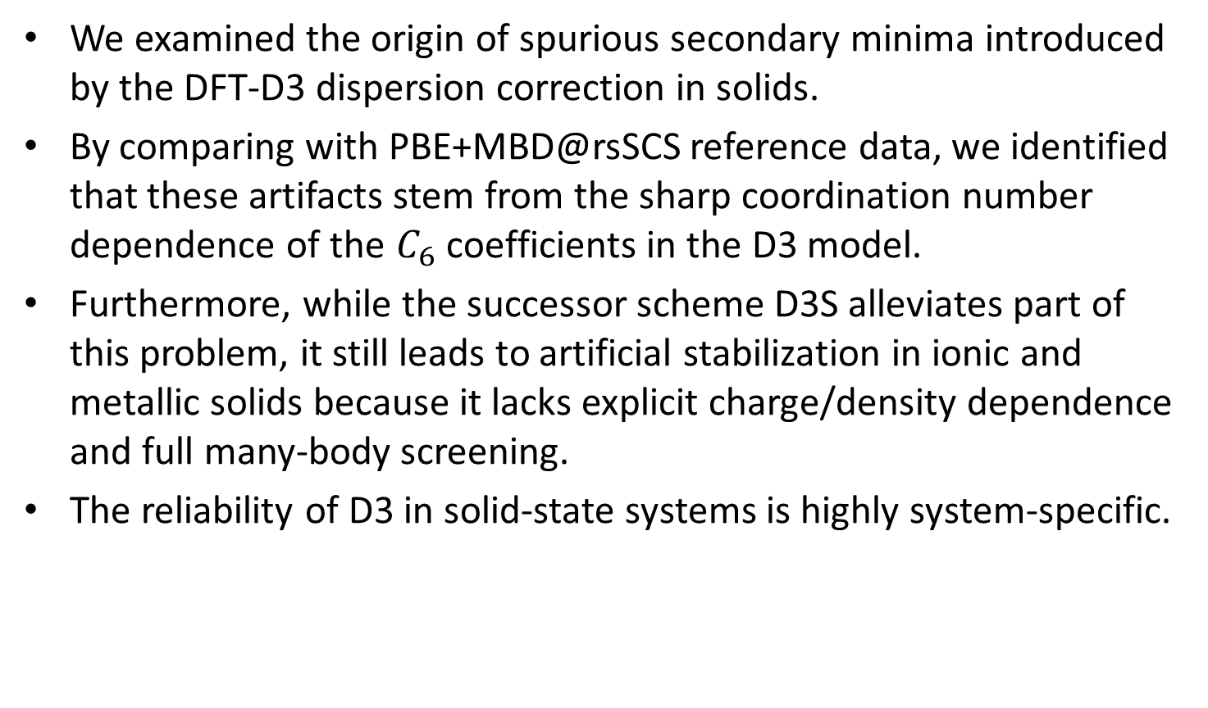
Conclusion
We examined the origin of spurious secondary minima introduced by the DFT-D3 dispersion correction in solids.
By comparing with PBE+MBD@rsSCS reference data, we identified that these artifacts stem from the sharp coordination number dependence of the $C_{6}$coefficients in the D3 model.
Furthermore, while the successor scheme D3S alleviates part of this problem, it still leads to artificial stabilization in ionic and metallic solids because it lacks explicit charge/density dependence and full many-body screening.
The reliability of D3 in solid-state systems is highly system-specific.

